Slide 1
Welcome to South Puget Sound SHRM! January 21, 2021
Please introduce yourself (name/company name) and
ask questions in the Chat feature.
We will start promptly at 8 AM.
Thanks for your patience!

Slide 2
Meet Your 2021 SPS SHRM Board
Chapter President – Wendi Modarelli Co-President Elect/Program Directors - Cheyanne Farr, SHRM-SCP Past President/SHRM Foundation Director – Katie Layton, SHRM-SCP, PHR Secretary & Membership Director - Kat Bosold Treasurer - Kirsten Willis, MBA/SPHR Hospitality Director – Michele Millsap Sponsorship Director – Daniel Smith Membership Director – Janette Roberton Legislative Director – Tina Shields, SHRM-CP, PHR Diversity Director – Renee Johnson, SHRM-SCP, SPHR Workforce Readiness Director – Maria Lopez College Relations Director - Taylor McFarland Certification Director – Jacquelyn Hoflich, SHRM-SCP, SPHR Social Media Director – Hannah Large, SPHR At Large Members – Karin Catey, SHRM-CP Supporting Member – Amber Amantea, SHRM-CP

Slide 3
Upcoming Event: 2021 HR Day on the Hill
Date: January 29, 2021
Time: 8:00 AM – 4:15 PM
Venue: Virtual
Visit sps.shrm.org/events for more information!

Slide 4
Thank You to our sponsors!
One Strategic Capital, Inc is a fully independent, fee for service advisory firm specializing in corporate retirement plans. From managing relationships with service providers, fee analysis and benchmarking, Investment Policy Statement development, or a fiduciary audit, we look forward to helping you navigate the complex waters of plan management.
Contact: Shane Dir, 206-397-4890, Shane@oscfp.com

Slide 5
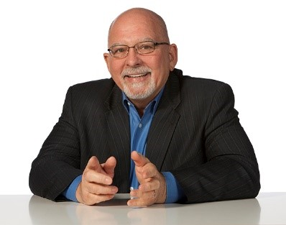
Today’s Speaker
Randy Boek is a Professional Outsider, Founder, and President of Route 2 Inc. Following service in Vietnam, he earned an undergraduate science degree and began a professional career in big, dirty, dangerous natural resources and heavy manufacturing international Fortune 500 companies.
He has been a leader in multiple start-ups, including a brewery, paper mill, and biofuel power plant. He is a coach and mentor to senior executives and their teams in fast-growing, privately-held businesses. Together with his partners, he works internationally and has developed leaders of leaders from fifteen countries.
His free time is devoted to a constant search for something to cook and the next great bottle of red wine to enjoy with family and friends. He is a passionate motorcyclist, always pursuing a twisty mountain road to enjoy rapidly on two wheels.

Slide 6
Leadership is Service
Building A Career of Influence Over Authority
Partners in Business Growth

Slide 7
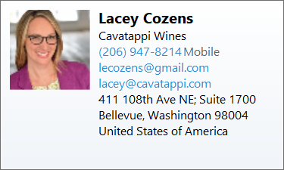

Slide 8
Thanks for participating!
Randy
425 359.8506 randyb@route2results.com

Slide 9
We want to hear from you!
Have specific topics you want to learn about?
Want to speak at a chapter meeting?
Want to get more involved in SHRM?
Curious of the benefits of sponsorship?
Don’t know what resources SHRM has to offer?
How to elect the SPS chapter as your designated chapter?
Email us at:
spsshrm.president@gmail.com
spsshrm.programs@gmail.com

Slide 10
Connect with us on Social Media!
Follow us on Facebook!
https://www.facebook.com/SouthPugetSoundSHRM
Follow us on Instagram!
@spsshrm
instagram.com/spsshrm
Follow us on LinkedIn!
http://linkedin.com/
company/spsshrm

